Slide 1
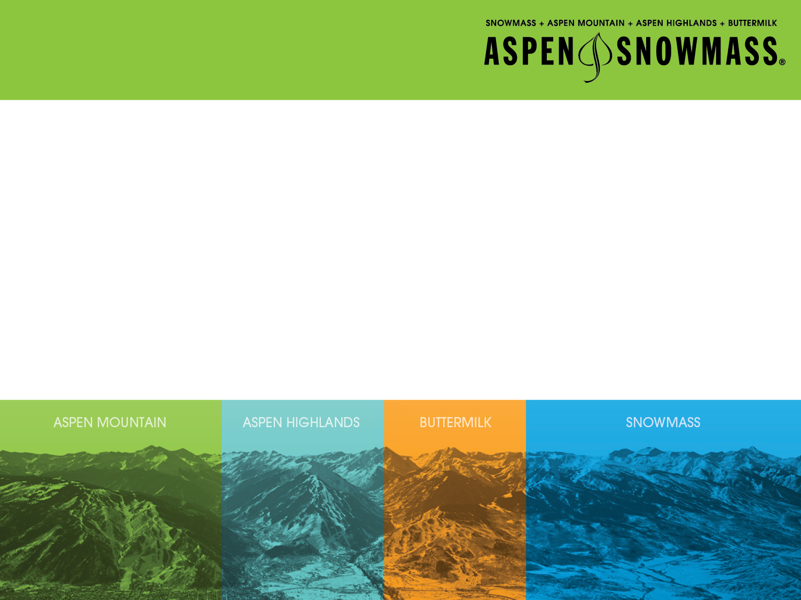

ADAPTIVE SNOWSPORTS:
THE NEW EMERGING MARKET
Notes:
1

Slide 2

Did You Know?
  Over 1.2 billion people in the world have a disability
  One in six families in the world have someone in their family with a disability
  Disabilities cross all financial classes. Examples:
    Christopher Reeves, Superman
    Steve Wynn, owner of the largest casino in Las Vegas, is totally blind
    Stephen Hawkins – world-famous Physicist
    Ernie Els, PGA golfer, has an autistic son
    Jordan Spieth, PGA golfer, has a sister with Downs Syndrome
  Autism’s newest statistic – in the United States, 1 in 68 children born are born with autism
  Disabilities are the largest minority in the world.
Notes:
http://www.telluridenews.com/articles/2013/05/02/news/doc5180481e8d4bf884851063.txt
CFA uses its funds to guarantee and increase the number of flights, mainly from Denver and a few other states, in order to promote the local economy. The guaranteed flights ensure airlines will break even or turn a profit, otherwise TMRAO will make up the difference.
http://www.watchnewspapers.com/view/full_story/22417628/article-TMRAO-Is-Now-Colorado-Flights-Alliance?instance=top_story

Slide 3
Did You Know? (continued)
  There are 3 ways an individual becomes disabled: 1st, at birth; 2nd through accident or disease; and 3rd by joining your country’s military and being injured.
  When a family member becomes disabled either from birth, accident, or being in their country’s military, what does the family do? They too take on a disability in their own way. We call that “a new normal” life.
  People all around the world have a lot of things in common. And all of us here tonight at Interski 2015 have something in common – we all know people, or have someone in our family with disabilities.
Notes:
http://www.telluridenews.com/articles/2013/05/02/news/doc5180481e8d4bf884851063.txt
CFA uses its funds to guarantee and increase the number of flights, mainly from Denver and a few other states, in order to promote the local economy. The guaranteed flights ensure airlines will break even or turn a profit, otherwise TMRAO will make up the difference.
http://www.watchnewspapers.com/view/full_story/22417628/article-TMRAO-Is-Now-Colorado-Flights-Alliance?instance=top_story

Slide 4
Please Stand Up
  Close eyes, hands on ears, one arm, one leg!
  Please sit down, paraplegic, quadriplegic, non-verbal
  Mental disabilities – 50% of disabilities are mental or cognitive. These include traumatic brain injuries, autism, Downs Syndrome, etc.
Notes:
http://www.telluridenews.com/articles/2013/05/02/news/doc5180481e8d4bf884851063.txt
CFA uses its funds to guarantee and increase the number of flights, mainly from Denver and a few other states, in order to promote the local economy. The guaranteed flights ensure airlines will break even or turn a profit, otherwise TMRAO will make up the difference.
http://www.watchnewspapers.com/view/full_story/22417628/article-TMRAO-Is-Now-Colorado-Flights-Alliance?instance=top_story

Slide 5
History of Adaptive Snowsports
  Vietnam War
  Children’s Hospital
  Paralympics – First held with the Olympics in Rome in 1960
Notes:
http://www.telluridenews.com/articles/2013/05/02/news/doc5180481e8d4bf884851063.txt
CFA uses its funds to guarantee and increase the number of flights, mainly from Denver and a few other states, in order to promote the local economy. The guaranteed flights ensure airlines will break even or turn a profit, otherwise TMRAO will make up the difference.
http://www.watchnewspapers.com/view/full_story/22417628/article-TMRAO-Is-Now-Colorado-Flights-Alliance?instance=top_story

Slide 6
Business and New Emerging Market
  Ski resorts
  Ski schools
  Lodging
  Returning Guests
Notes:
http://www.telluridenews.com/articles/2013/05/02/news/doc5180481e8d4bf884851063.txt
CFA uses its funds to guarantee and increase the number of flights, mainly from Denver and a few other states, in order to promote the local economy. The guaranteed flights ensure airlines will break even or turn a profit, otherwise TMRAO will make up the difference.
http://www.watchnewspapers.com/view/full_story/22417628/article-TMRAO-Is-Now-Colorado-Flights-Alliance?instance=top_story

Slide 7
Partnerships
  Ski Area Owners
  Ski Area Management
  Ski Area Ski Schools
  Ski Area Family Members
  Local Community Leaders
  Local Community Businesses
  Local Community Schools
Notes:
http://www.telluridenews.com/articles/2013/05/02/news/doc5180481e8d4bf884851063.txt
CFA uses its funds to guarantee and increase the number of flights, mainly from Denver and a few other states, in order to promote the local economy. The guaranteed flights ensure airlines will break even or turn a profit, otherwise TMRAO will make up the difference.
http://www.watchnewspapers.com/view/full_story/22417628/article-TMRAO-Is-Now-Colorado-Flights-Alliance?instance=top_story

Slide 8
Market
  Private Schools and Families
  Family Ski Vacations
  Adaptive Program Collaboration
  Travel and Tourism – private, public, national marketing, etc. Again, 1 in 6 families have someone with a disability.
  Baby Boomers – born between 1946 and 1964 are considered “baby boomers,” which might just be an American term. This group is a key market. They are still active and continue to want to ski with family – children and grandchildren. With adaptive equipment, they can continue to enjoy skiing even having had physical disabilities such as knee replacements, etc.
Notes:
http://www.telluridenews.com/articles/2013/05/02/news/doc5180481e8d4bf884851063.txt
CFA uses its funds to guarantee and increase the number of flights, mainly from Denver and a few other states, in order to promote the local economy. The guaranteed flights ensure airlines will break even or turn a profit, otherwise TMRAO will make up the difference.
http://www.watchnewspapers.com/view/full_story/22417628/article-TMRAO-Is-Now-Colorado-Flights-Alliance?instance=top_story

Slide 9
Why Snowsports for People with Disabilities?
  Level playing field – mountains, snow, water
  Adaptive equipment – in snowsports we all use adaptive equipment, whether it be ski boots, snowboard boots, poles, skis. It’s all adaptive, just different for our gifted guests with disabilities
  The snowboard came originally for surfboards
  Kayak, canoe, raft, etc – when you see these on the water, can you tell who is disabled?
Notes:
http://www.telluridenews.com/articles/2013/05/02/news/doc5180481e8d4bf884851063.txt
CFA uses its funds to guarantee and increase the number of flights, mainly from Denver and a few other states, in order to promote the local economy. The guaranteed flights ensure airlines will break even or turn a profit, otherwise TMRAO will make up the difference.
http://www.watchnewspapers.com/view/full_story/22417628/article-TMRAO-Is-Now-Colorado-Flights-Alliance?instance=top_story

Slide 10
Athletes, Competition
  Paralympics, extreme skiing, X-Games, Special Olympics, etc
  Gold-medalist winning times for Olympic and Paralympic competitors
Notes:
http://www.telluridenews.com/articles/2013/05/02/news/doc5180481e8d4bf884851063.txt
CFA uses its funds to guarantee and increase the number of flights, mainly from Denver and a few other states, in order to promote the local economy. The guaranteed flights ensure airlines will break even or turn a profit, otherwise TMRAO will make up the difference.
http://www.watchnewspapers.com/view/full_story/22417628/article-TMRAO-Is-Now-Colorado-Flights-Alliance?instance=top_story

Slide 11
Military (CAMO Challenge Aspen Military Opportunities)
  Every country I believe represented in this room has a military and unfortunately needs a military
  Our injured military members deserve this opportunity
  This program has national, regional, and local patriotism and loyalty
  Potential large sponsorship opportunites
Notes:
http://www.telluridenews.com/articles/2013/05/02/news/doc5180481e8d4bf884851063.txt
CFA uses its funds to guarantee and increase the number of flights, mainly from Denver and a few other states, in order to promote the local economy. The guaranteed flights ensure airlines will break even or turn a profit, otherwise TMRAO will make up the difference.
http://www.watchnewspapers.com/view/full_story/22417628/article-TMRAO-Is-Now-Colorado-Flights-Alliance?instance=top_story

Slide 12
Conclusion
  In the past 20 years, since starting Challenge Aspen, we have learned a lot, which I am sharing with you tonight. Why did I call this presentation “Adaptive Snowsports: The New Emerging Market”
  Economics – 2 million dollars came to Aspen Skiing Company from the Challenge Aspen adaptive program. Over 5,000 adaptive skier days were taught last ski season. THEY DO NOT COME ALONE.
  At least 5 family members came for each disabled skier. This equates to more than 25,000 additional skier days for Aspen Skiing Company through that they would not have had without the Challenge Aspen adaptive ski program.
  How can you also incorporate the adaptive snowsports market into your ski area, ski school
Notes:
http://www.telluridenews.com/articles/2013/05/02/news/doc5180481e8d4bf884851063.txt
CFA uses its funds to guarantee and increase the number of flights, mainly from Denver and a few other states, in order to promote the local economy. The guaranteed flights ensure airlines will break even or turn a profit, otherwise TMRAO will make up the difference.
http://www.watchnewspapers.com/view/full_story/22417628/article-TMRAO-Is-Now-Colorado-Flights-Alliance?instance=top_story

Slide 13
Conclusion (continued)
  New Business and Potential Huge Market. Remember 1 in 6 families throughout the world have someone with a disability.
  You build it and they will come. When you have an adaptive program your guests will be loyal and they will return every year.
  Incorporate an entire family with the snowsports experience. The family, on average, will spend from $2,000 to $6,000 USD per day at your ski area and taking lessons. This does not include transportation or airfare.
Notes:
http://www.telluridenews.com/articles/2013/05/02/news/doc5180481e8d4bf884851063.txt
CFA uses its funds to guarantee and increase the number of flights, mainly from Denver and a few other states, in order to promote the local economy. The guaranteed flights ensure airlines will break even or turn a profit, otherwise TMRAO will make up the difference.
http://www.watchnewspapers.com/view/full_story/22417628/article-TMRAO-Is-Now-Colorado-Flights-Alliance?instance=top_story

Slide 14
Conclusion (continued)
  Partnerships
    Everyone wins. The owner of the ski area. The ski schools. The ski pro’s. The businesses. The local economy.
    The community embraces this new emerging market
  The Market
    Baby Boomers, family ski vacations, private schools with their families, adaptive program collaboration. Remember, 1 in 6 families have someone in their family with a disability.
  Marketing
    Travel and tourism
Notes:
http://www.telluridenews.com/articles/2013/05/02/news/doc5180481e8d4bf884851063.txt
CFA uses its funds to guarantee and increase the number of flights, mainly from Denver and a few other states, in order to promote the local economy. The guaranteed flights ensure airlines will break even or turn a profit, otherwise TMRAO will make up the difference.
http://www.watchnewspapers.com/view/full_story/22417628/article-TMRAO-Is-Now-Colorado-Flights-Alliance?instance=top_story

Slide 15
Change the World
YOU CAN CHANGE THE WORLD ONE LIFE AT AT TIME.
I guarantee you will go home at the end of the day, every day, saying
“A job well done.”
Notes:
http://www.telluridenews.com/articles/2013/05/02/news/doc5180481e8d4bf884851063.txt
CFA uses its funds to guarantee and increase the number of flights, mainly from Denver and a few other states, in order to promote the local economy. The guaranteed flights ensure airlines will break even or turn a profit, otherwise TMRAO will make up the difference.
http://www.watchnewspapers.com/view/full_story/22417628/article-TMRAO-Is-Now-Colorado-Flights-Alliance?instance=top_story

Slide 16
Interactive Workshops This Week
You are invited this week to evening workshops
to learn more and ask questions about
ADAPTIVE SNOWSPORTS: THE NEW EMERGING MARKET
.
Notes:
http://www.telluridenews.com/articles/2013/05/02/news/doc5180481e8d4bf884851063.txt
CFA uses its funds to guarantee and increase the number of flights, mainly from Denver and a few other states, in order to promote the local economy. The guaranteed flights ensure airlines will break even or turn a profit, otherwise TMRAO will make up the difference.
http://www.watchnewspapers.com/view/full_story/22417628/article-TMRAO-Is-Now-Colorado-Flights-Alliance?instance=top_story

Slide 17


THANK YOU!
Facebook.com/ChallengeAspen
Twitter.com/ChallengeAspen
Notes:
17

